Slide 1

Linux
Operating System

Slide 2
Topic 1
LAB 3

Slide 3
Agenda
Lab 3:
fork()
wait()
exec()
getpid()
getppid()

Slide 4
HEADER
FILES
Topic 1
#include <header>

Slide 5
Some important header files
Before we get started with the code, we are going to explain some important header files to include within our code.

Slide 6
Some included header files Cont.
These involve:
1
#include <sys/types.h>
3
#include <stdio.h>
2
#include <sys/wait.h>
4
#include <unistdio.h>

Slide 7
Header Files Cont.
1
#include <sys/types.h>
The sys/types.h header file defines a collection of typedef symbols and structures.
We only need:
pid_t: Used for process ID.

Slide 8
Header Files Cont.
2
#include <sys/wait.h>
- The sys/wait.h header file declares many functions, used for holding processes.
We only need:
wait(int *wstatus): Used to wait for state changes in a child of
the calling process.

Slide 9
Header Files Cont.
3
#include <stdio.h>
The stdio.h header file has the necessary information to include the input/output related functions in our program.
Examples: printf, scanf … etc.
We only need:
fprintf: Used to print the string content in file, not on stdout console.
printf: Used to print character stream of data on stdout console.

Slide 10
Header Files Cont.
4
#include <unistd.h>
The unistd.h header file provides access to the POSIX operating system API.
Examples: fork, exec, getpid … etc.
We only need:
fork: Used to fork a child process.
execlp: Used to print character stream of data on stdout console.
getpid: returns the process ID (PID) of the calling process.
getppid: returns the process ID (PID) of the parent of the calling process.

Slide 11
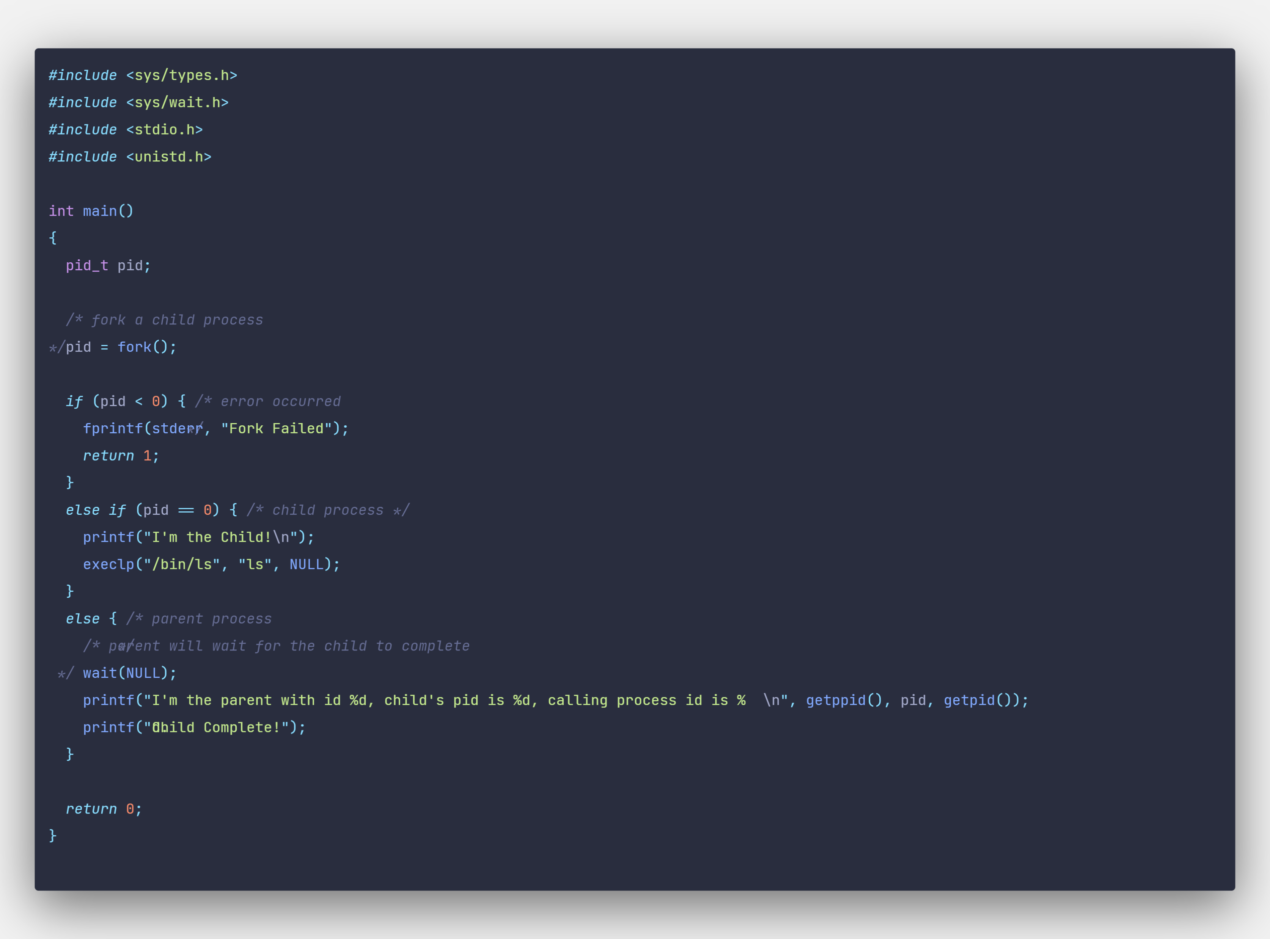
Program Codes

Slide 12
The End.
!
Thank You

